Slide 1
Getting Involved With Your Local Public Library

Slide 2
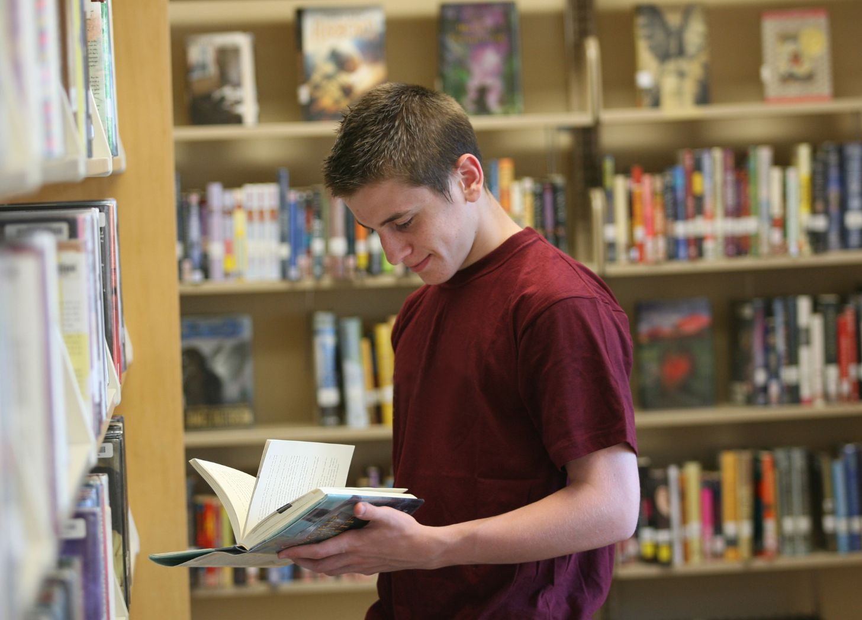
Starting Simple
Borrow books, ebooks, movies, music, and other items available at your library
Take books from the displays
Request books you’d like that you do not see
Ask questions! Your librarians at the desk are there to help you with research, reading recommendations, and more.
Notes:
Borrowing materials is a very easy way to support the library. Sounds super simple, but it is effective--when materials are borrowed, that shows interest in their use. This is especially true for books that have been banned or are books by or about marginalizerd people.
Book displays are not meant to be there permanently, either. They’re there to help people find books on topics they might be interested in or discover an interest in a topic they didn’t know they had. Feel free to borrow everything on a display. It’ll get refilled.
One of the things teens are often most surprised to learn is they can request the library purchase books. Look for request forms either at the library or online on the library’s website. If they’re not easy to find, just ask!
Something worth mentioning is that libraries often have other really unique items that people can borrow beyond what one might expect. This could include steamers (for getting rid of creases in pants or graduation gowns), movie projectors and screens, wifi hotspots, musical instruments, costume exchanges, food pantry materials, and more.

Slide 3
Attend Events
Libraries offer lectures, movie screenings, themed events, and more
Author visits and talks happen in person and virtually
Take part in your library’s summer reading programs
Even better: bring a friend for anything you attend!
All of these things are almost always free.
Notes:
Mention here that in addition to “attending events,” teens can simply hang out at the library. Use the study rooms or computers, read a book in a comfy chair, or engage in any passive programming that might be offered. It is THEIR SPACE as much as anyone else’s. So long as it is respected as it should be and rules are followed, teens deserve to be there, too.

Slide 4
Use Online Resources
Libraries provide a wide array of databases you can use for research and homework
Poke around to see what ebooks, digital audiobooks, or digital magazines are available
Looking for a newspaper story and find a paywall online? Your library might provide access
Notes:
Simply using things at the library is beneficial!

Slide 5

Join a Teen Advisory Board
Help make decisions on library collection purchases
Give input and create programs for people your age
Have your voice represented and heard
Teen advisory boards exist because the library wants you to be involved. Library doesn’t have one? Talk with your library about starting one–even if it’s just a few of your friends, that helps get things going and grows interest!

Slide 6
Volunteer with the Library
Some libraries have specific volunteer programs
  Reading buddies
  Shelf reading
  Summer programming help
Other libraries keep a list of projects and/or are able to help you find the appropriate project for your skills
Most libraries have a “Volunteer” section on their website that explains what opportunities they have. If not, you can always ask!
Notes:
Some examples of specific volunteer programs include reading buddies, where teens volunteer to read to and with younger kids; shelf reading, which allows for ensuring materials are on shelf where they are supposed to be; summer programming help might include preparing materials for programs or helping run programs.

Slide 7
Get Involved with Friends of the Library
Volunteer fundraising group
Every Friends group is different, but they often oversee used book sales and other regular fundraising events
Don’t like asking for money or selling things? Friends groups often have other ways you can help, too!
Look for information on your public library’s website. “Friends of the library” is the usual name, but it might be called something slightly different.
Notes:
Because public libraries are taxpayer funded, they have little bonus money to cover costs for special programs or unique needs in the library. That’s where groups like the Friends come in.
Other common fundraiser events Friends groups run in various public libraries besides the used book sales include indoor mini golf events, sales of flowers or specialty treats with a portion of sales going back to the library, and more.
This isn’t the case everywhere, of course, but it is common for the Friends to be primarily older individuals because they have more time and resources to volunteer for causes they care about. Young people would be welcomed where they can and it not only helps the Friends reach new demographics but helps build intergenerational community. Those bonds are powerful!

Slide 8
Write a Letter & Spread the Word
Letters to the library about what they are doing good are always welcome
Have a local newspaper? Write a short letter to the editor praising the library.
Use social media–talk up your local library on community Facebook pages or highlight something cool you saw on the library website on your own social media accounts
Consider submitting letters to the Library Board praising efforts at the library
  Can be simple! Say you LOVED a book display they put up and that it led you to finding a new thing to read.
  Can be short! Three sentences is fine.
Check your library’s website for Library Board contact information and your local paper for rules about Letters to the Editor, such as word limit and where to submit them.
Notes:
One reason letters to the library board are so important is that, like when speaking to the board, you’ll be on the record. That information becomes permanent and public, so people can look through and see the praise for the library. Library workers won’t always submit letters they get personally to the board (though they often do), so this does double duty.

Slide 9
Go to Library Board Meetings
This is the key piece of speaking up and out about book censorship when it is happening in your public/school library, of course. But if that isn’t happening in your community, you can still go to these meetings.
Be sure to understand what your rights are and what rules or policies you need to follow (for example, do you need to sign up beforehand to speak? Do you have a time limit?
Peruse the meeting agenda to know what topics are being discussed, as well as when public comment begins.
You don’t need to stay the entire time! If you only want to stay for public comment because nothing else is on the agenda that pertains to you, feel free to duck out.
Notes:
Remember: you can simply go and say the library is awesome and you love it, if you’re not there for any specific reason related to book challenges or censorship. This is AWESOME advocacy and it is especially powerful to hear from the voices of young people.
You’ll be practicing advocacy at a board meeting in the next Lesson.

Slide 10
Can You Think of Other Ways to Get Involved With Your Local Library?
Notes:
Feel free to use this space as a facilitator to talk about your unique institutions, and allow students to share what they know about their own if it is not your library. Mention that taking advantage of programs like this very one are outstanding ways to be library advocates.

